Slide 1
Depth estimation
Unsupervised Monocular Depth Estimation with Left-Right Consistency
Unsupervised Learning of Depth and Ego-Motion from Video
220713 랩세미나 발표 : 김소희

Slide 2
Unsupervised Monocular Depth Estimation with Left-Right Consistency
Godard, Clément, Oisin Mac Aodha, and Gabriel J. Brostow.
Proceedings of the IEEE conference on computer vision and pattern recognition. 2017.

Slide 3
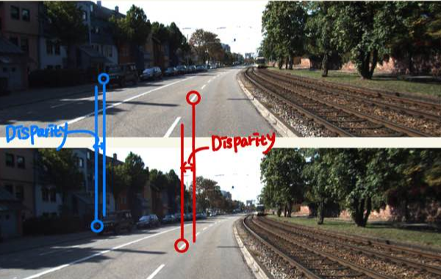
Unsupervised Monocular Depth Estimation with Left-Right Consistency
Introduction
Depth estimation
이전의 많은 연구들 : multiple observation 이 가능하다는 가정 아래 진행 (여러 이미지)
한계 극복 : supervised learning 방식의 mono depth estimation 방법론 (하나의 이미지) 연구됨
Depth 기반 데이터 수가 많아야 함. (수집 힘듦)
Our Method - Unsupervised Monocular depth estimation
Depth data 필요하지 않음
Left
Depth estimation
Stereo : Left, right image → 두 이미지의 차이 disparity
Mono : 하나의 image만을 가지고 depth 추정
Right
https://skk095.tistory.com/4
Notes:
Differentiable : 미분가능한

Slide 4
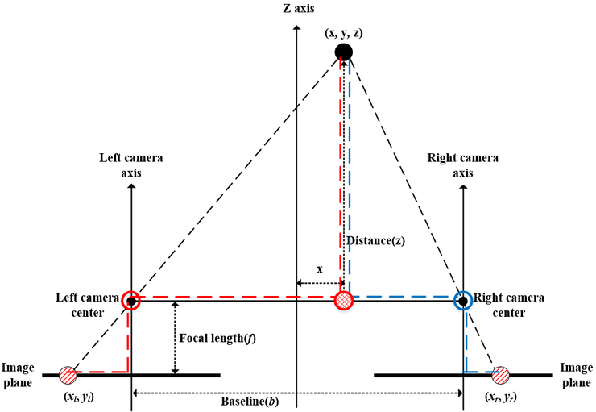
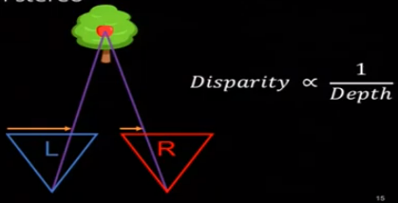
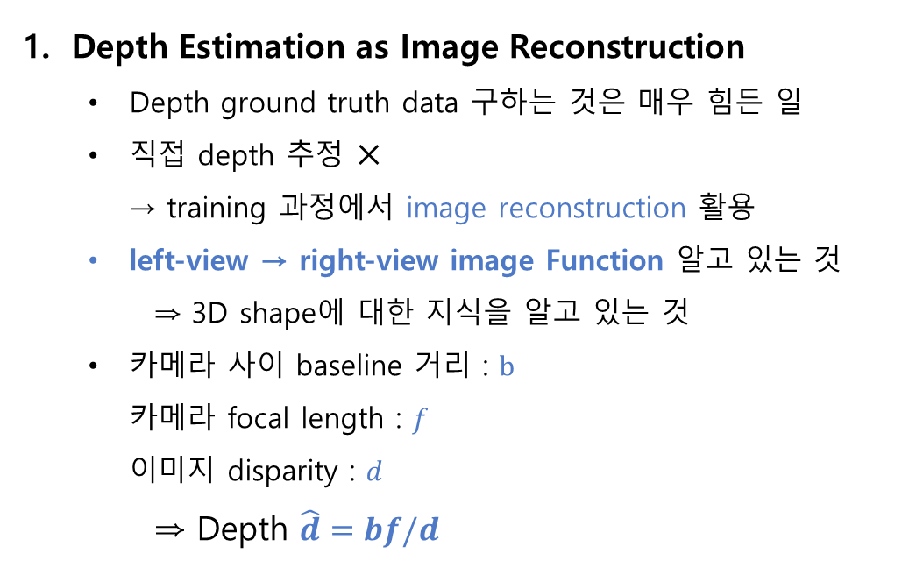
Unsupervised Monocular Depth Estimation with Left-Right Consistency
Method
Depth Estimation as Image Reconstruction
Depth ground truth data 구하는 것은 매우 힘든 일
직접 depth 추정 ✕ → training 과정에서 image reconstruction 활용
left-view → right-view image Function 알고 있는 것
⇒ 3D shape에 대한 지식을 알고 있는 것
카메라 사이 baseline 거리 : $b$ 카메라 focal length : $f$ 이미지 disparity : $d$
⇒ Depth $\hat{d}=bf/d$
https://www.youtube.com/watch?v=jI1Qf7zMeIs

Slide 5
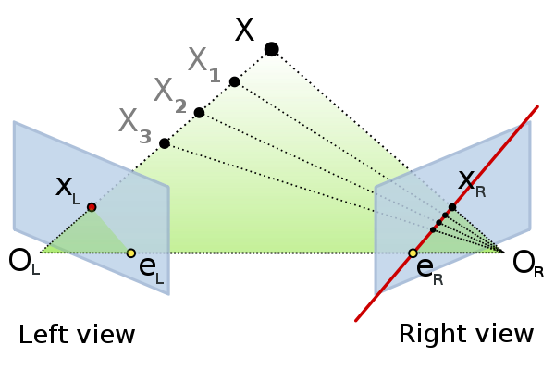
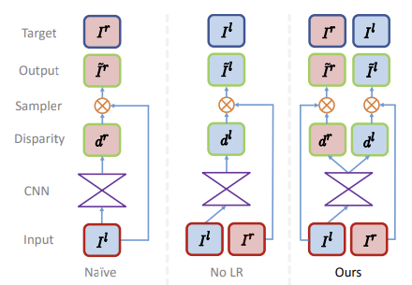
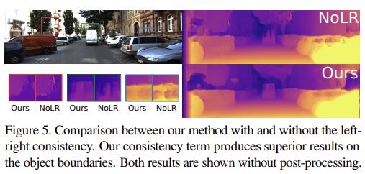
Unsupervised Monocular Depth Estimation with Left-Right Consistency
Method
Depth Estimation Network
left-to-right, right-to-left disparities 모두 구할 수 있으며, 서로 consistency를 유지하게 함으로써 더 좋은 성능
기존의 연구
na¨ıve : Left → Right image
No LR : Right → Left image
‘texture copy’ artifact 라는 현상
Depth가 연속적이지 않은 부분에서 error 많이 발생
Ours : 두가지 disparity map 생성
Left image 하나만 필요, right image는 training에서만 사용
Left-right consistency loss 이용 - 더 정확
Encoder + Decoder (skip connection)
Output disparity predictions – 4 different scales
Input : single image ⇒ Output : 2 disparity maps at each scale

Slide 6
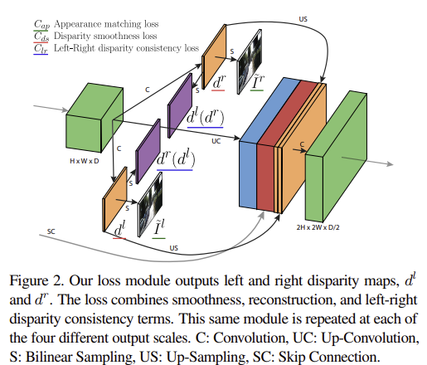
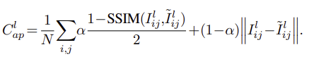
Unsupervised Monocular Depth Estimation with Left-Right Consistency
Method
3. Training Loss
1) Appearance Matching Loss (Image construction loss)
Opposite stereo image로부터 image를 생성하도록 학습시킴
Left + right disparity -> image construction
Left image에 right disparity를 적용해 right image를 얻고, Right image에 left disparity를 적용해 left image를 얻은 후 각각 위 과정을 통해 얻은 이미지와 실제 left, right 이미지와의 SSIM 비교를 통해서 유사정도를 파악해 Loss를 측정
Combination of L1 and SSIM
SSIM : structural similarity 인간의 시각적 화질 차이 평가
3x3 block filter, α=0.85
Notes:
Opposite stereo image로부터 image를 생성하도록 학습시킴
Spatial transformer network 사용하여 disparity map 만듦
Bilinear sampler 사용 : locally fully differentiable, fully convolutional architecture
Do not require any simplification or approximation
구체적으로는 원본 이미지 x와 왜곡 이미지 y의 brightness, contrast, structure를 비교한다.

Slide 7
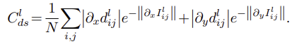
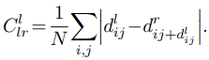
Unsupervised Monocular Depth Estimation with Left-Right Consistency
Method
3. Training Loss
2) Disparity Smoothness Loss
Disparity가 locally smooth 하게 하는 효과
Disparity 경계 영역에서 끊어짐이 발생하지 않도록 gradient x, y 등을 측정하는 loss
3) Left-Right Disparity Consistency Loss
더 정확한 disparity map을 만들기 위해
left-view disparity map == projected right-view disparity map
모델을 통해 나온 left disparity에 right disparity를 이용해 새로운 right disparity를 얻고, 마찬가지로 right disparity에 left disparity를 이용해 새로운 left disparity를 얻어 원래의 right disparity, left disparity와 비교를 하는 loss

Slide 8
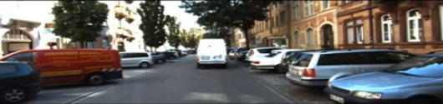
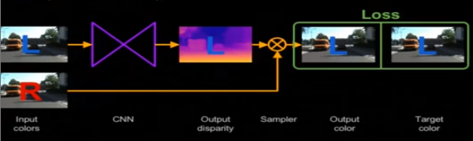
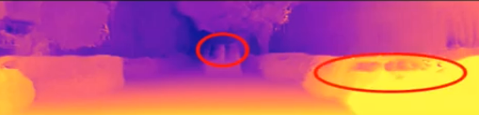
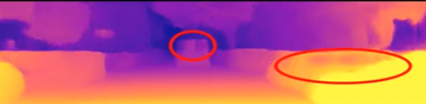
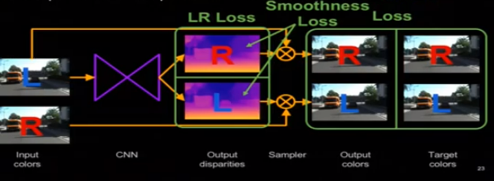
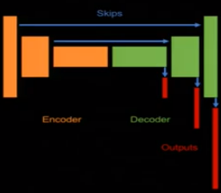
Unsupervised Monocular Depth Estimation with Left-Right Consistency
Method
Depth Estimation method
Baseline→
> Baseline
Ours→
Encoder + Decoder (skip connection)
Multiscale generation (and loss)
> Ours
https://www.youtube.com/watch?v=jI1Qf7zMeIs

Slide 9
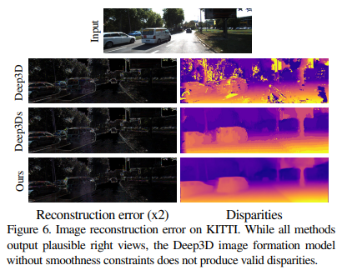
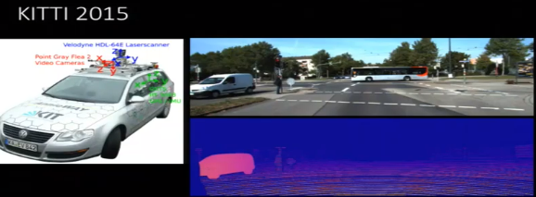
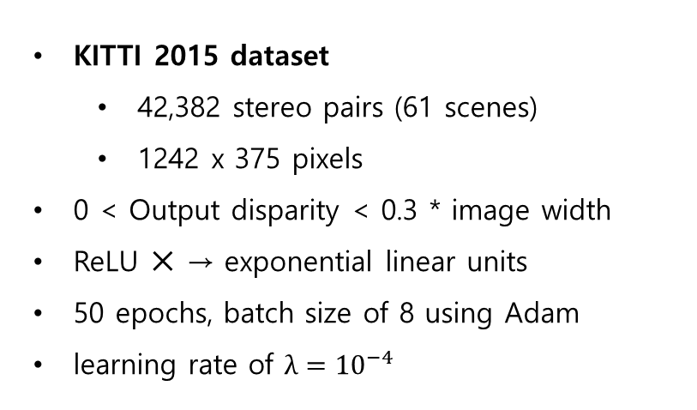
Unsupervised Monocular Depth Estimation with Left-Right Consistency
Results
KITTI 2015 dataset
42,382 stereo pairs (61 scenes)
1242 x 375 pixels
0 < Output disparity < 0.3 * image width
ReLU ✕ → exponential linear units
50 epochs, batch size of 8 using Adam
learning rate of $λ={10}^{−4}$
Deep3D -> plausible image reconstructions
But output disparities are inferior to ours
https://www.youtube.com/watch?v=jI1Qf7zMeIs

Slide 10
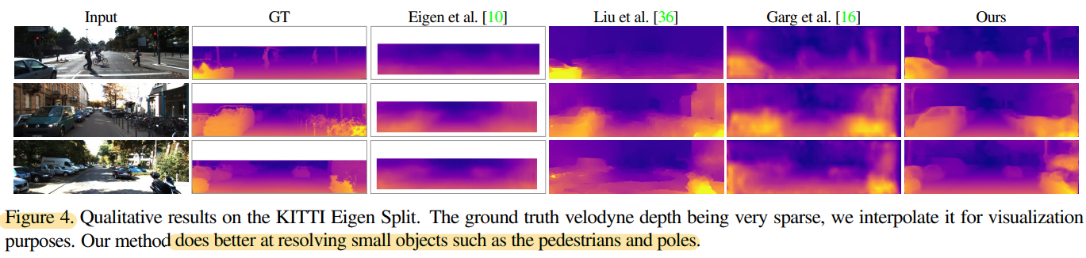
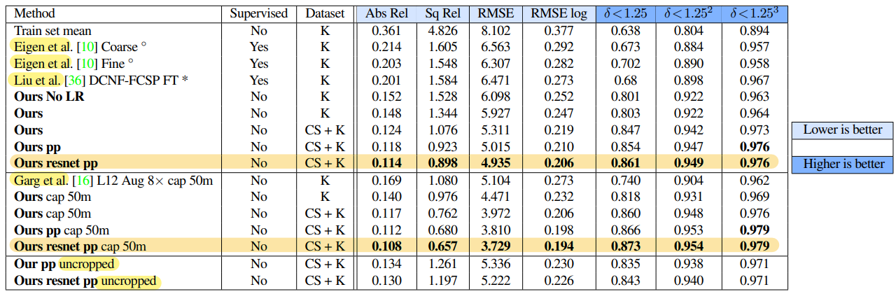
Unsupervised Monocular Depth Estimation with Left-Right Consistency
Results
KITTI Dataset
first pre-training our model with additional training data from the Cityscapes dataset
KITTI 와 비슷한 세팅, but higher resolution, image quality, and variety

Slide 11
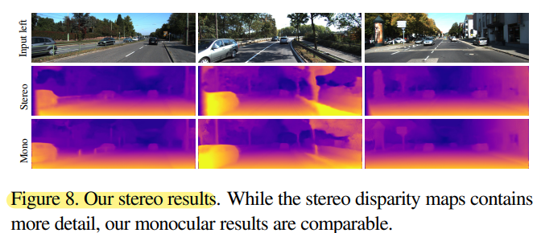
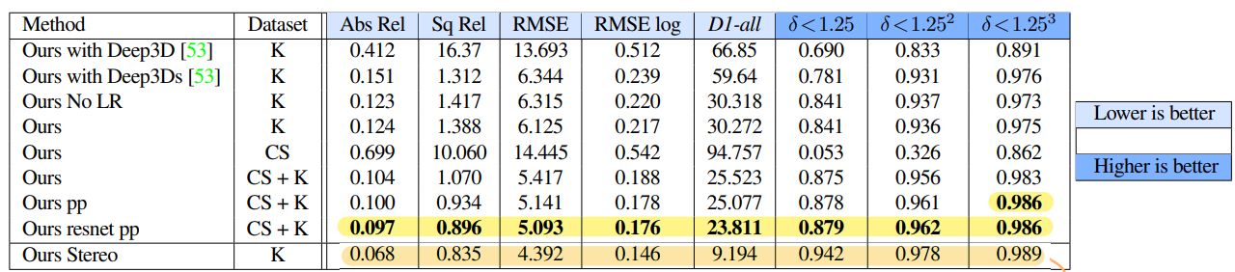
Unsupervised Monocular Depth Estimation with Left-Right Consistency
Results
Stereo results
Input : concatenation of both left and right views
-> Tested with two images

Slide 12
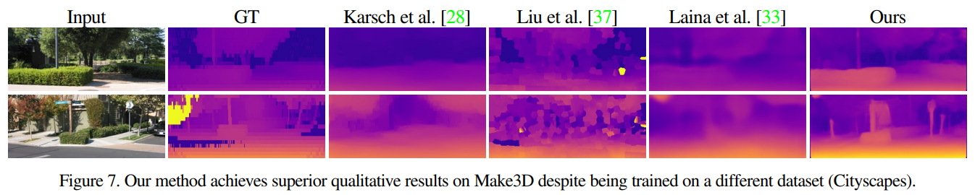
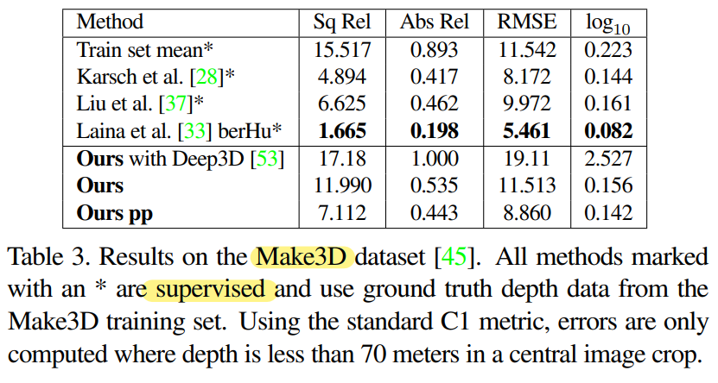
Unsupervised Monocular Depth Estimation with Left-Right Consistency
Results
Cityscapes Dataset – Make3D test
Make3D test set (RGB/Depth pairs으로 구성)
Cityscapes dataset 로만 train

Slide 13
Unsupervised Monocular Depth Estimation with Left-Right Consistency
Results
Limitation
Some artifacts visible at occlusion boundaries (occlusion region – 두 이미지에 존재하지 않는 부분)
Requires rectified and temporally aligned stereo pairs during training
Not possible to use existing single-view datasets for training purposes
Rely on image reconstruction term
Specular and transparent surfaces (반사된, 투명한 표면) will produce inconsistent depths
Conclusion
Unsupervised deep neural network for single image depth estimation
Self-supervision with stereo data -> cheap and scalable
Accurate – beats fully-supervised methods on KITTI

Slide 14
Unsupervised Learning of Depth and Ego-Motion from Video
Tinghui Zhou, Matthew Brown, Noah Snavely, and David G. Lowe
Proceedings of the IEEE conference on computer vision and pattern recognition. 2017.

Slide 15
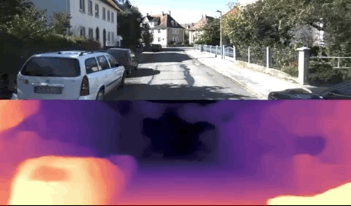
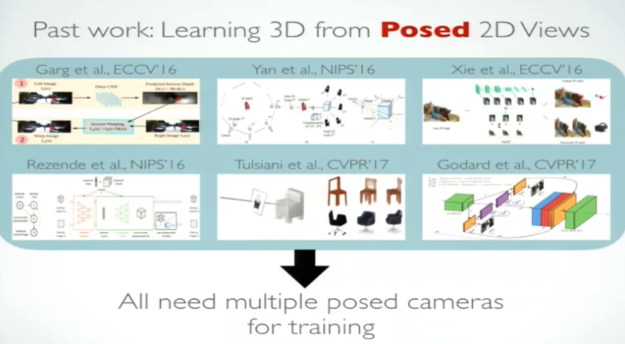
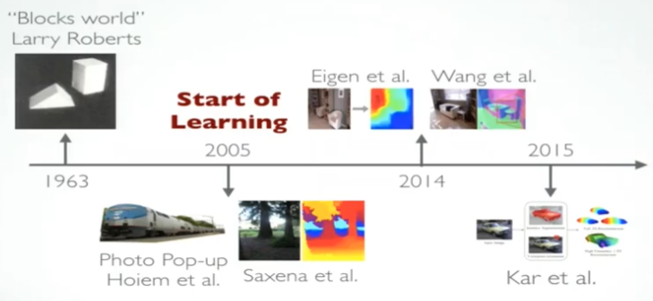
Unsupervised Learning of Depth and Ego-Motion from Video
Introduction
Past work : Single Image 3D prediction
Supervised methods
Require ground truth data – 수집하기 어려움
Our methods - unsupervised
하나의 움직이는 카메라로 수집한 비디오에 대해 train 가능
https://www.youtube.com/watch?v=HWu39YkGKvI

Slide 16
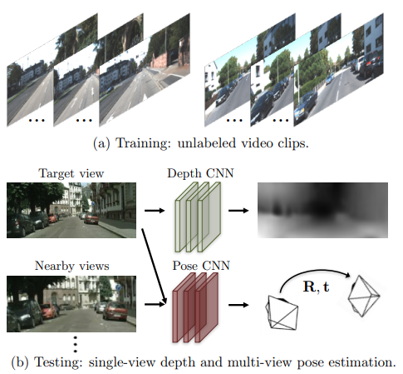
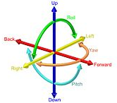
Unsupervised Learning of Depth and Ego-Motion from Video
Introduction
Joint Learning of Depth and Pose
Input : sequences of images
Predict camera motion & depth map (end-to-end)
입력된 이미지
→ 6-DoF의 ego-motion 파라미터 추정
→ depth map으로 표현되는 scene structure 추정
추정된 두 정보 → 프레임간 view synthesis 생성
둘 간의 차이 = loss ~training
Unsupervised
Single-view depth
Multi-view camera pose

Slide 17
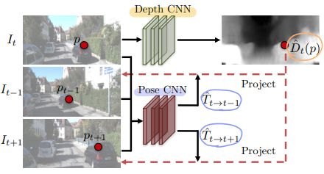
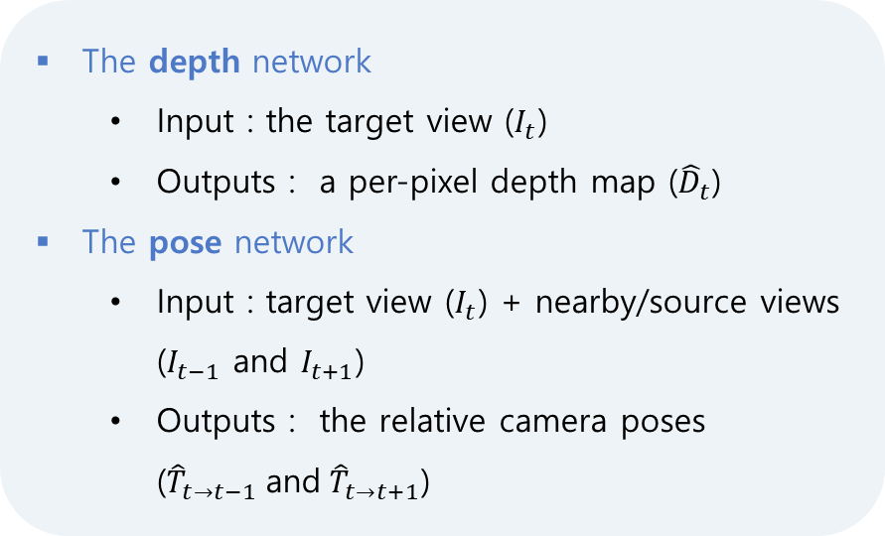
Unsupervised Learning of Depth and Ego-Motion from Video
Approach
Learning pipeline – Depth and Pose estimation
The depth network
Input : the target view ($I_{t}$)
Outputs : a per-pixel depth map (${\hat{D}}_{t}$)
The pose network
Input : target view ($I_{t}$) + nearby/source views ($I_{t−1}$ and $I_{t+1}$)
Outputs : the relative camera poses (${\hat{T}}_{t→t−1} \text{and} {\hat{T}}_{t→t+1}$)
target
source
source
2가지 네트워크의 outputs
Inverse warp the source views to reconstruct the target view (source + inverse warp → target view)
Source 이미지의 픽셀 값과 target 이미지로 projection 시킨 위치의 픽셀 값과의 차이 = loss
Training CNN : photometric reconstruction loss 사용

Slide 18
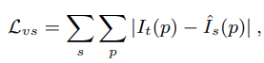
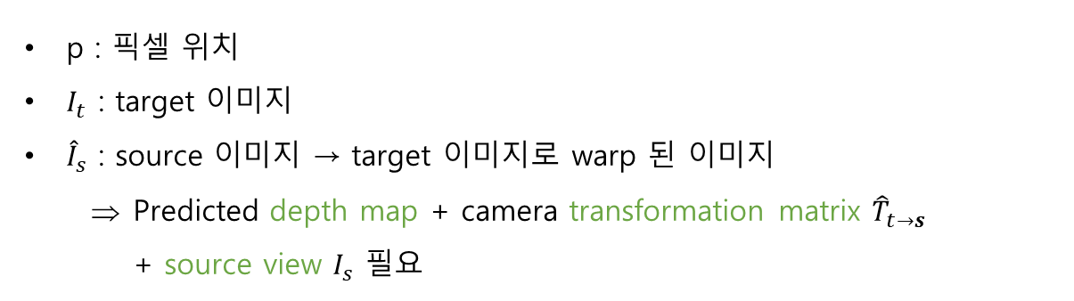
Unsupervised Learning of Depth and Ego-Motion from Video
Approach
View synthesis as supervision
이 방법의 핵심 : View synthesis 생성
Source 이미지 + 그에 대한 depth map + target 이미지로의 transformation ⇒ target 이미지 생성
Fully differentiable → CNN 학습에 사용할 수 있다
p : 픽셀 위치
$I_{t}$ : target 이미지
${\hat{I}}_{s}$ : source 이미지 → target 이미지로 warp 된 이미지
Predicted depth map + camera transformation matrix ${\hat{T}}_{t→s}$ + source view $I_{s}$ 필요
> Objective function
기존 연구 : Training에 posed image 필요
Ours : pose information 없이 train 가능, 예측할 수 있음

Slide 19
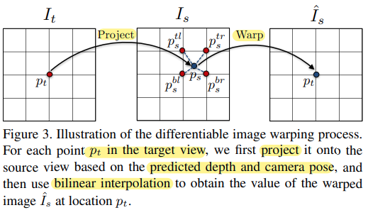
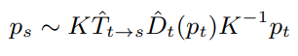
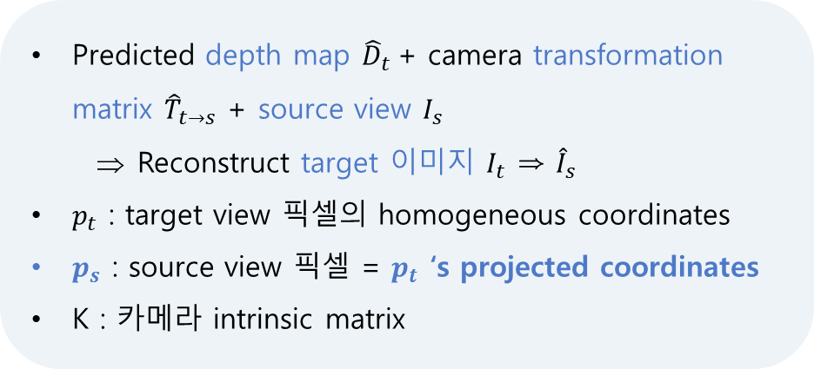
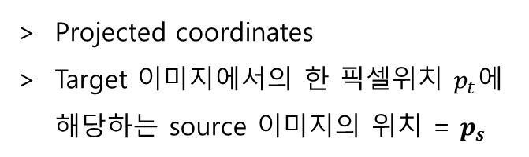
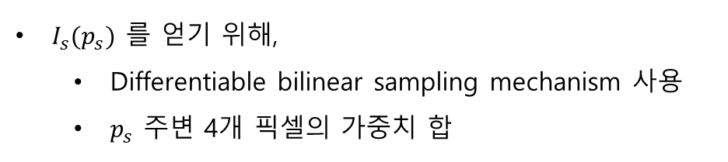
Unsupervised Learning of Depth and Ego-Motion from Video
Approach
2. Differentiable depth image-based rendering
Predicted depth map ${\hat{D}}_{t}$+ camera transformation matrix ${\hat{T}}_{t→s}$ + source view $I_{s}$
Reconstruct target 이미지 $I_{t}$ ⇒ ${\hat{I}}_{s}$
$p_{t}$ : target view 픽셀의 homogeneous coordinates
$p_{s}$ : source view 픽셀 = $p_{t}$ ‘s projected coordinates
K : 카메라 intrinsic matrix
$I_{s}(p_{s})$ 를 얻기 위해,
Differentiable bilinear sampling mechanism 사용
$p_{s}$ 주변 4개 픽셀의 가중치 합
Projected coordinates
Target 이미지에서의 한 픽셀위치 $p_{t}$에 해당하는 source 이미지의 위치 = $p_{s}$

Slide 20
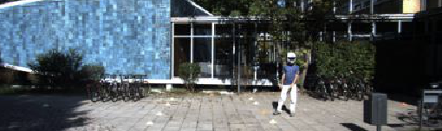

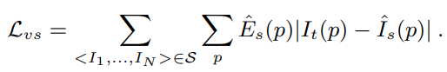
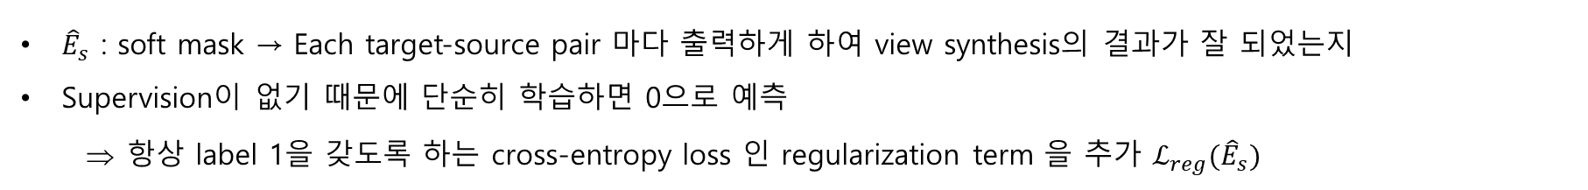
Unsupervised Learning of Depth and Ego-Motion from Video
Approach
3. Modeling the model limitation
Monocular video에서 view synthesis를 생성할 때 가정하는 것
움직이는 객체 없음 static without moving objects
두 이미지에서 가려지거나 서로 교차하는 영역 없음 no occlusion/disocclusion
Surface is Lambertian – photo-consistency 에 차이가 있는 경우, 서로 다른 영역임
가정이 깨지는 경우 → 학습할 때 gradient가 부정확하게 되어 training 방해
Explainability prediction network 추가 (to improve the robustness)
> Explainability mask
> Objective function
${\hat{E}}_{s}$ : soft mask → Each target-source pair 마다 출력하게 하여 view synthesis의 결과가 잘 되었는지
Supervision이 없기 때문에 단순히 학습하면 0으로 예측
항상 label 1을 갖도록 하는 cross-entropy loss 인 regularization term 을 추가 ${ℒ_{reg}(\hat{E}}_{s})$

Slide 21
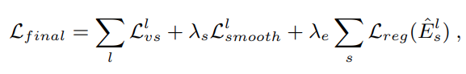
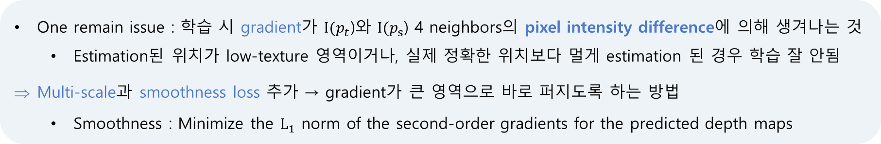
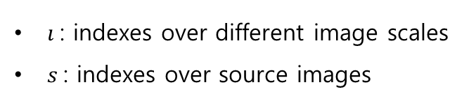
Unsupervised Learning of Depth and Ego-Motion from Video
Approach
4. Overcoming the gradient locality
One remain issue : 학습 시 gradient가 $I{(p}_{t}$)와 $I{(p}_{s}$) 4 neighbors의 pixel intensity difference에 의해 생겨나는 것
Estimation된 위치가 low-texture 영역이거나, 실제 정확한 위치보다 멀게 estimation 된 경우 학습 잘 안됨
Multi-scale과 smoothness loss 추가 → gradient가 큰 영역으로 바로 퍼지도록 하는 방법
Smoothness : Minimize the $L_{1}$ norm of the second-order gradients for the predicted depth maps
> Final Objective function
Smoothness loss
Explainability regularization
$ı$: indexes over different image scales
$s$: indexes over source images
weighting

Slide 22
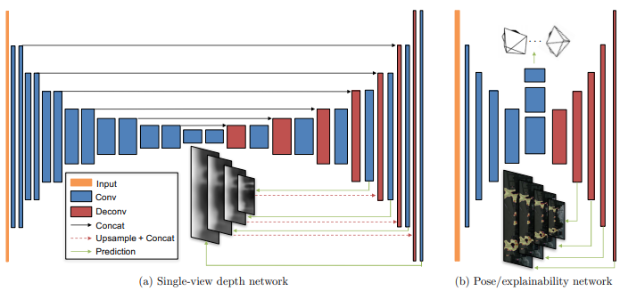
Unsupervised Learning of Depth and Ego-Motion from Video
Approach
5. Network architecture
Pose
Input : target view와 모든 source 이미지를 concatenate
Outputs : target view 와 각 모든 source views 사이의 relative poses
Stride-2 convolutions *7개 + 1x1 convolution *1개
Output channels : 6*(N-1)
Global average pooling
Explainability mask
Pose network의 5개의 encoding layer의 출력에 각각 deconvolution layer를 붙여 만듦
Output channels : 2*(N-1)
2 채널 마다 softmax로 학습 시켜 explainability를 prediction하도록 하였다.
Single-view depth
DispNet architecture을 수정
Encoder-decoder + skip connections, multi-scale side predictions
Depth=1/(α ∗ sigmoid(x) + β) with α = 10 and β = 0.01
Depth가 항상 positive이고 적절한 범위 내 이도록

Slide 23
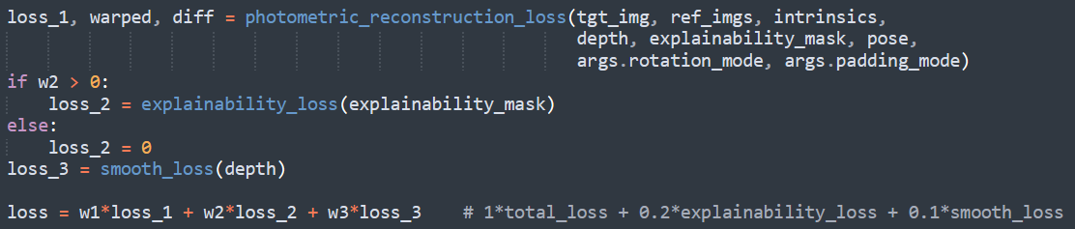
Unsupervised Learning of Depth and Ego-Motion from Video
Code
Train
Loss

Slide 24
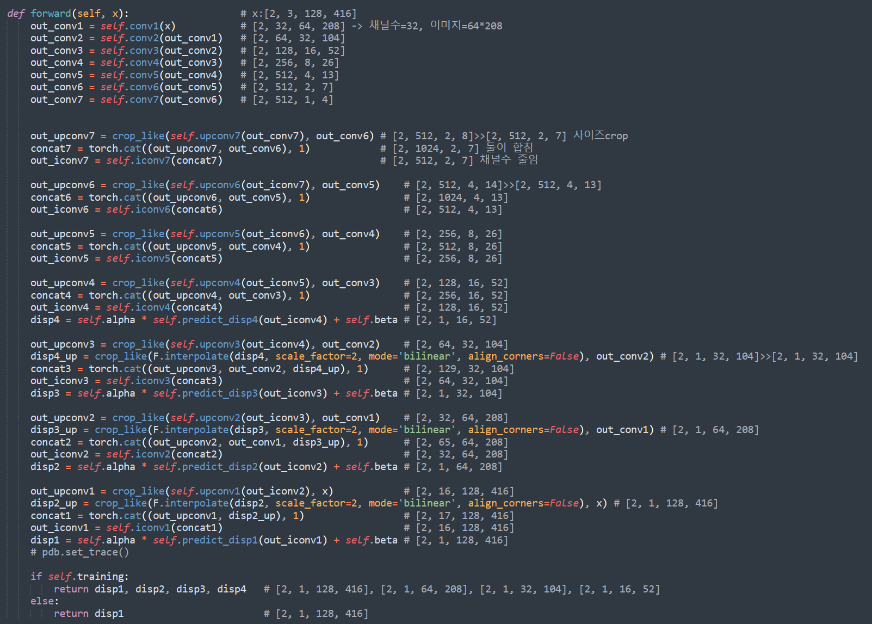
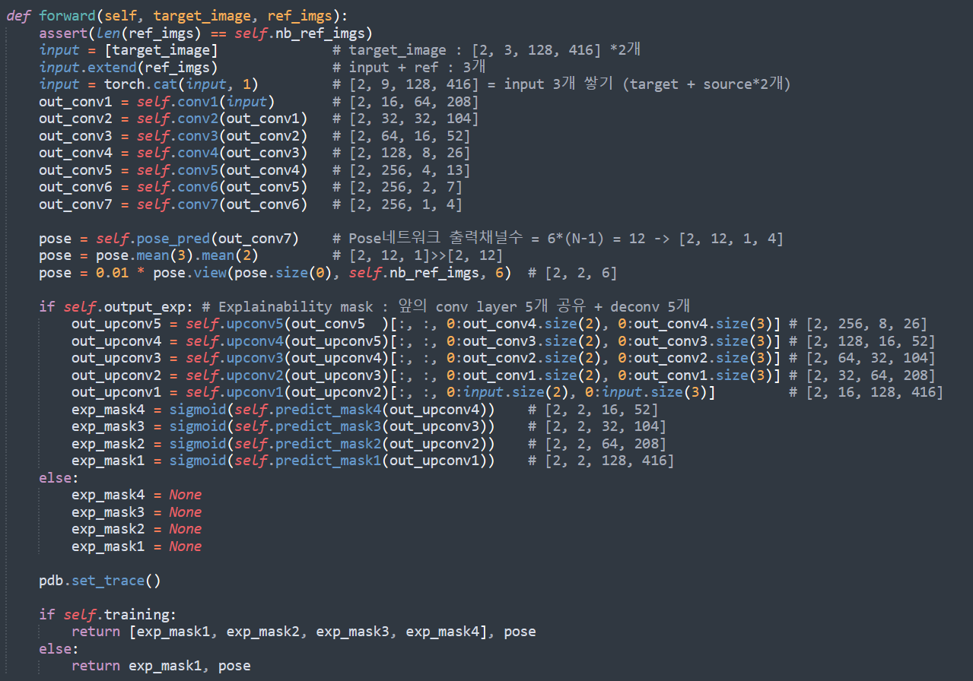
Unsupervised Learning of Depth and Ego-Motion from Video
DispNet – Depth estimation
PoseExpNet – Pose, explainability mask

Slide 25







Unsupervised Learning of Depth and Ego-Motion from Video
Code Result
Learning pipeline – Depth and Pose estimation
Dispnet
(disparity map)
Depth
t-1
Warp
t
t+1

Slide 26

Unsupervised Learning of Depth and Ego-Motion from Video
Experiments
Single-view depth estimation
KITTI 2015 dataset - Resize 128 x 416 during training

Slide 27


Unsupervised Learning of Depth and Ego-Motion from Video
Experiments
Single-view depth estimation
Supervised baselines
< Unsupervised Ours
Sometime struggles
Vast open scenes
카메라 앞에 가까이 있는 object

Slide 28



Unsupervised Learning of Depth and Ego-Motion from Video
Experiments
Single-view depth estimation
Cityscapes Dataset
Make3D Dataset
Pre-trained on Cityscapes, fine-tuned on KITTI
CS – 차와 bushes의 정확한 shape 구변 못함, 멀리 있는 물체 실수
Train – CityScapes + KITTI
Test – Make3D

Slide 29


Unsupervised Learning of Depth and Ego-Motion from Video
Experiments
Pose estimation
Fix the length of input image sequences to our system to 5 frames
Two variants of monocular ORB-SLAM
ORB-SLAM(full) – all frames of the driving sequences
ORB-SLAM(short) – 5 frame snippets (same as Ours)
Outperforms Mean Odom, ORB-SLAM(short)
Falls short of ORB-SLAM(full)

Slide 30

Unsupervised Learning of Depth and Ego-Motion from Video
Experiments
Visualizing the explainability prediction
1-3 rows
Dynamic objects
4, 5 rows
Objects that disappear form the frame
6, 7 rows
얇은 구조를 unexplainable로 간주함 (explainability-weighted loss의 잠재적문제)

Slide 31
Unsupervised Learning of Depth and Ego-Motion from Video
Discussion
End-to-end learning pipeline
Utilizes the task of view synthesis for supervision of single-view depth and camera pose estimation
-> trained on unlabeled videos (not require ground-truth depth and pose for training)
Major challenges
Does not explicitly estimate scene dynamics and occlusions
Assumes the camera intrinsics are given. – 아무 인터넷 비디오 ✕
Depth maps are a simplified representation of the underlying 3D scene. 단순하게 표현한 것

Slide 32


Unsupervised Monocular Depth Estimation with Left-Right Consistency
Related Work
Learning-Based Stereo
Each pixel in the first image → every other pixel in the second image : 모든 픽셀의 similarity 계산
대부분의 stereo pairs는 정제되어 있으며, disparity estimation은 각 픽셀의 1D search 문제
최근 Hand defined similarity measure 보다 matching as supervised learning problem : 더 좋은 성능
Mayer et al. DispNet : fully convolutional deep network
predict the disparity of each pixel, by minimizing a regression training loss
많은 수의 ground truth disparity data, stereo image pairs 필요

Slide 33
Unsupervised Monocular Depth Estimation with Left-Right Consistency
Related Work
Supervised Single Image Depth Estimation
Saxena et al. Make3D : patch-based model. Laser scan data 이용하여 학습, MRF 활용하여 prediction 결합.
단점 : 얇은 구조물을 modeling 하는데 적절하지 않음 = 현실적인 이미지를 만드는데 적절치 않음
Liu et al. CNN 사용
Karsch et al. consistent한 image output 노력 → training set으로부터 depth image 복사하여 이룸
한계 : Test 할 때, 모든 training set이 필요함
Eigen et al. Multi-scale deep network 활용
이전까지는 single image depth estimation 이였지만,
이들은 hand craft feature를 사용하지 않았고, raw pixel value를 활용하여 learn a representation
많은 연구들이 CRF 기반으로 accuracy 향상을 이룸
이런 접근법들은 training 할 때, 높은 quality, pixel aligned, ground truth data에 의존

Slide 34



Unsupervised Monocular Depth Estimation with Left-Right Consistency
Related Work
> Make3D
> Eigen et al. Multi-scale deep network

Slide 35
Unsupervised Monocular Depth Estimation with Left-Right Consistency
Related Work
Unsupervised Depth Estimation (No ground truth depth at training time)
Flynn et al. Deep Stereo : 새로운 view 이미지 생성 by selecting pixels from nearby images
Training 하는 동안, 다양한 카메라의 상대적인 pose가 근처 이미지의 모습을 만들어내는데 사용됨
Test 할 때, image 합성은 겹쳐지는 작은 patch에서 작동
단점 : 근처의 다른 posed image 가 필요 → monocular depth estimation 에 부적절
Xie et al. Deep3D network : left image 기반 → right image 생성
Reconstruction loss 활용, 각 픽셀에 대해서 가능한 disparities에 대해서 분포 만듦
단점 : difficult to scale their approach to bigger output resolution (메모리 문제)
Garg et al. monocular depth estimation + reconstruction loss (Like Deep3D & ours)
한계 : fully differentiable 하지 않음 => Taylor approximation을 사용
Fully convolutional deep neural network (inspired by DispNet)
Disparity field without ground truth depth → posing monocular depth estimation as an image reconstruction problem
Includes left-right consistency check → improve quality of synthesized depth images

Slide 36



Unsupervised Monocular Depth Estimation with Left-Right Consistency
Related Work
> Xie et al. Deep3D
> Garg et al .

